Slide 1
Testbed 3 Welcome
13 September 2021

Slide 2
Outline
Aims of Testbed 3
Testbed schedule
Useful links
Determining roles
Training
Daily communications: meetings and drop-in zoom call
In-country Testbed tasks
UK Testbed tasks
Testbed 3 legacy

Slide 3
Aims of Testbed 3
To test the usefulness of specific tools and methods for operational short-term forecasting and nowcasting of high-impact weather in tropical Africa, namely:
  Synthetic forecasting approaches, including newly-developed East African Synthetic Forecasts.
  Ensemble prediction of high impact storms, using both global ensembles and regional convection-permitting ensembles.
  Satellite-based nowcasting tools, especially NWC-SAF.
To engage with expert users throughout the testbed, providing them with bespoke nowcasts and to adapt our methods based on their feedback.
To carry out real-time verification of forecasts and evaluation of forecasts with users.

Slide 4
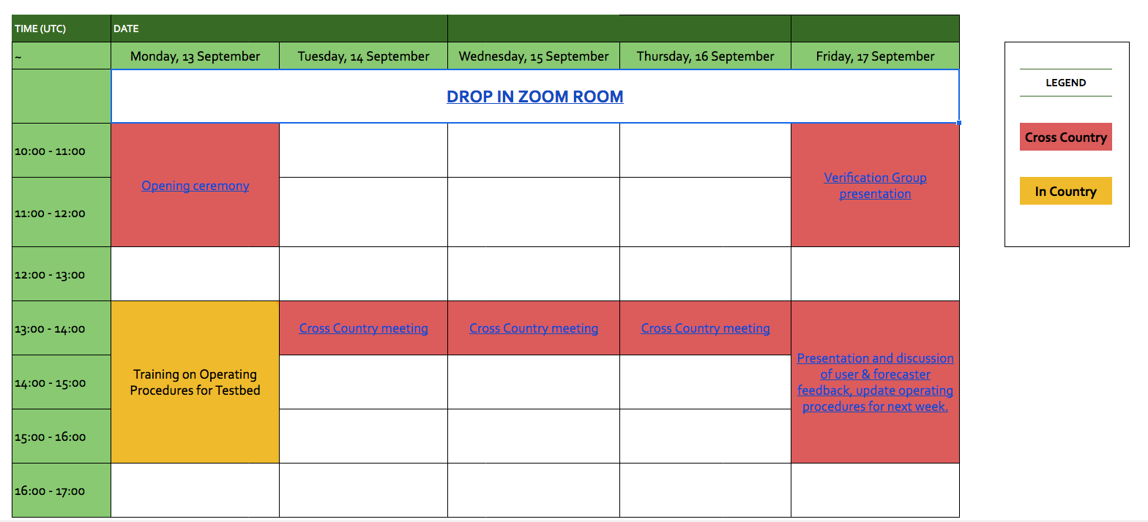
Link to Testbed 3 Schedule

Slide 5
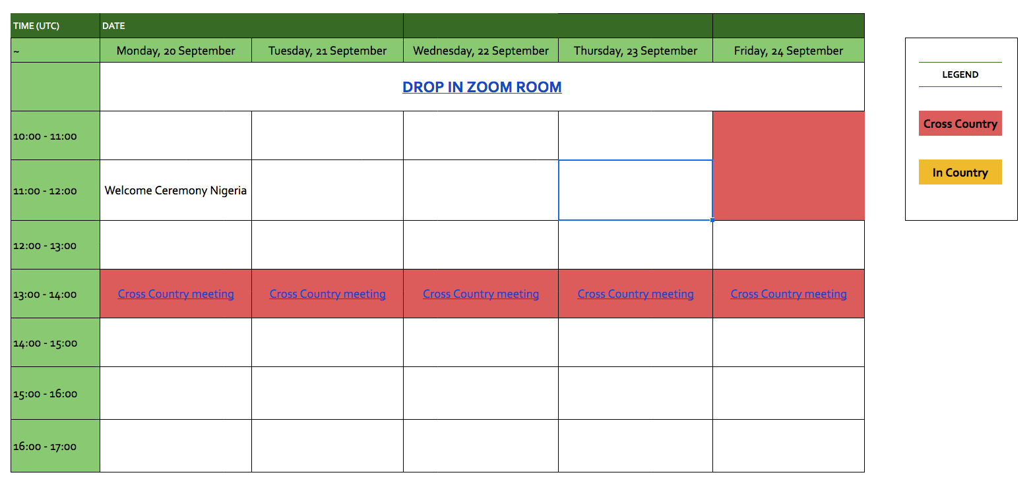
Link to Testbed 3 Schedule

Slide 6
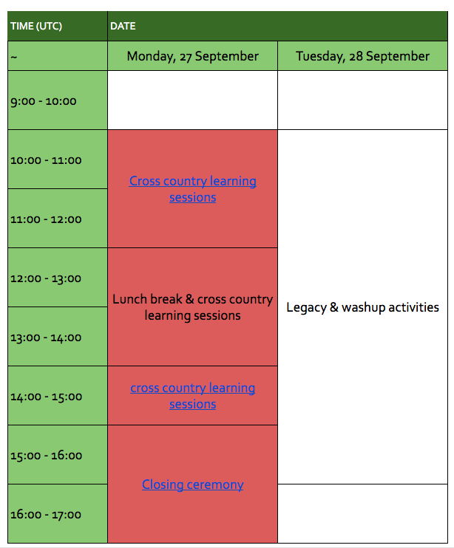
Link to Testbed 3 Schedule

Slide 7
Useful links
This page contains links to forecasting and nowcasting products, documents describing the operating procedures for forecasting and nowcasting during the testbed, and templates to be used.
https://docs.google.com/document/d/1btVhtb04ATcEbS0YJNGLyftCrjdcKubPTWnmqgR4KrA/edit?usp=sharing

Slide 8
Determining Roles
Synoptic forecasting
Nowcasting
Forecast verification
Nowcasting verification
Evaluation with users
Scientific Secretary

Slide 9
Determining Roles: Synoptic forecasting
Ideally a small team who will prepare the synoptic forecasts each day and provide a brief to the nowcasting team. If possible, synoptic forecasters should focus their testbed efforts prior to 13:00 UTC. Synoptic forecasters are also responsible for sending ensemble forecast information to users once per day.

Slide 10
Determining Roles: Nowcasting
Ideally a small team who will carry out nowcasting each day and send nowcasting products to users every two hours. They will likely focus their efforts later in the day, from 14:00 UTC.

Slide 11
Determining Roles: Forecast Verification
This person or people will be carrying out objective, quantitative verification following the methods learned in the Verification Training. The forecast data used in that training will be available on JASMIN in the same format as it was during the training.

Slide 12
Determining Roles: Nowcasting Verification
This person or people will fill in a table each day documenting any high impact weather events that occurred the previous day. They will also ensure that any rain gauge or wind observations are saved for later documentation purposes, or they will enter those observations into the table. UK participants will be responsible for filling in the remaining information on this table. This could be done by a person who also does nowcasting, or it could be its own separate role.

Slide 13
Determining Roles: Evaluation with users
This person or people will be responsible for requesting regular feedback from users on the forecast products and documenting this feedback and delivering it to Testbed participants, including in the cross-country event on Friday 17 September. The questions to be asked users have been distributed by Victor Indasi.

Slide 14
Determining Roles: Scientific Secretary
This person is responsible for ensuring that the following documents are preserved and uploaded to Redmine each day. If they cannot get a Redmine account the scientific secretary can email the documents to Jennifer each day:
  Synoptic forecast template sheet, filled in.
  All nowcasting products sent to users that day.
  Any forecast verification documents produced that day.
  Nowcasting verification for the previous day.
  Any documentation of evaluation with users for that day.
  Notes of any other important items such as technical problems, significant weather events, changes to operating procedure, etc.
  The names of everyone working on the Testbed that day, and their roles. This and the above can be filled in using the appropriate google form which is linked on the Useful Links document.

Slide 15
Training
Training today will cover the following:
  Ensembles (if not already done last week)
  Synoptic forecasting standard operating procedure (SOP) to be followed during the testbed.
  Filling in the synoptic forecast daily template.
  Nowcasting training
  Nowcasting SOP to be followed during the testbed.
  Filling in the nowcasting template, which will be done every two hours during the daily nowcasting period.

Slide 16
Daily Communications
Daily zoom meeting at 13:00 UTC
  Very short (about 5 minutes each) weather brief from each country, starting with a regional brief from ACMAD.
  Very short report from each country on how things are going, including:
    Any feedback from users.
    Any technical or logistic challenges.
    Any issues with SOPs.

Slide 17
Daily Communications
Zoom drop-in call open 09:00 UTC to 18:00 UTC
  One person from each Testbed location should keep this call open and muted. They do not need to monitor the call but keep it open and in hearing distance.
  If someone wishes to speak to someone at another Testbed location, they can join the zoom call and shout for them – hopefully someone will hear and come!
  The discussion can occur in a breakout room so as not to distract others who have the call open.

Slide 18
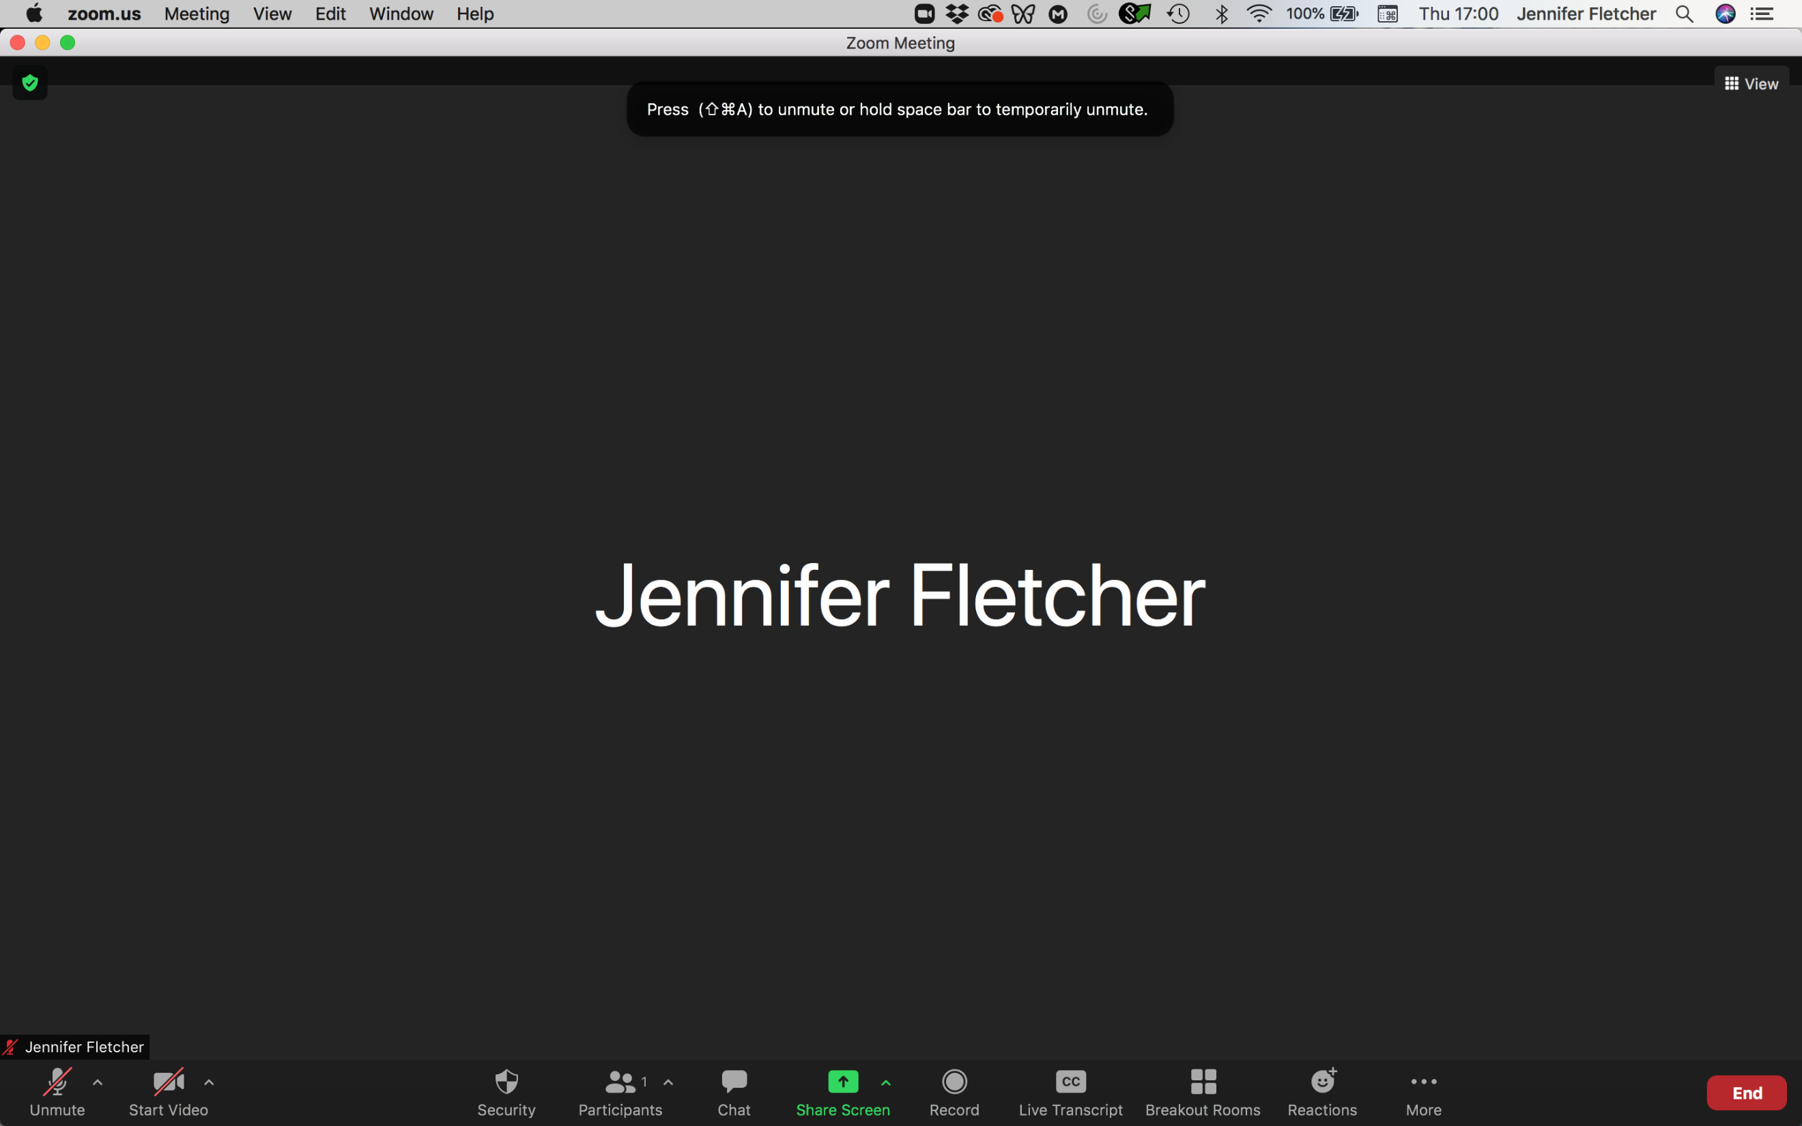
Daily Communications
Daily zoom meeting at 13:00 UTC
  Very short weather brief from each country.
  Very short report from each country on how things are going, including:
    Any feedback from users.
    Any technical or logistic challenges.
    Any issues with SOPs.
Zoom drop-in call open 09:00 UTC to 18:00 UTC
  One person from each Testbed location should keep this call open and muted. They do not need to monitor the call but keep it open and in hearing distance.
  If someone wishes to speak to someone at another Testbed location, they can join the zoom call and shout for them – hopefully someone will hear and come!
  The discussion can occur in a breakout room so as not to distract others who have the call open.

Slide 19
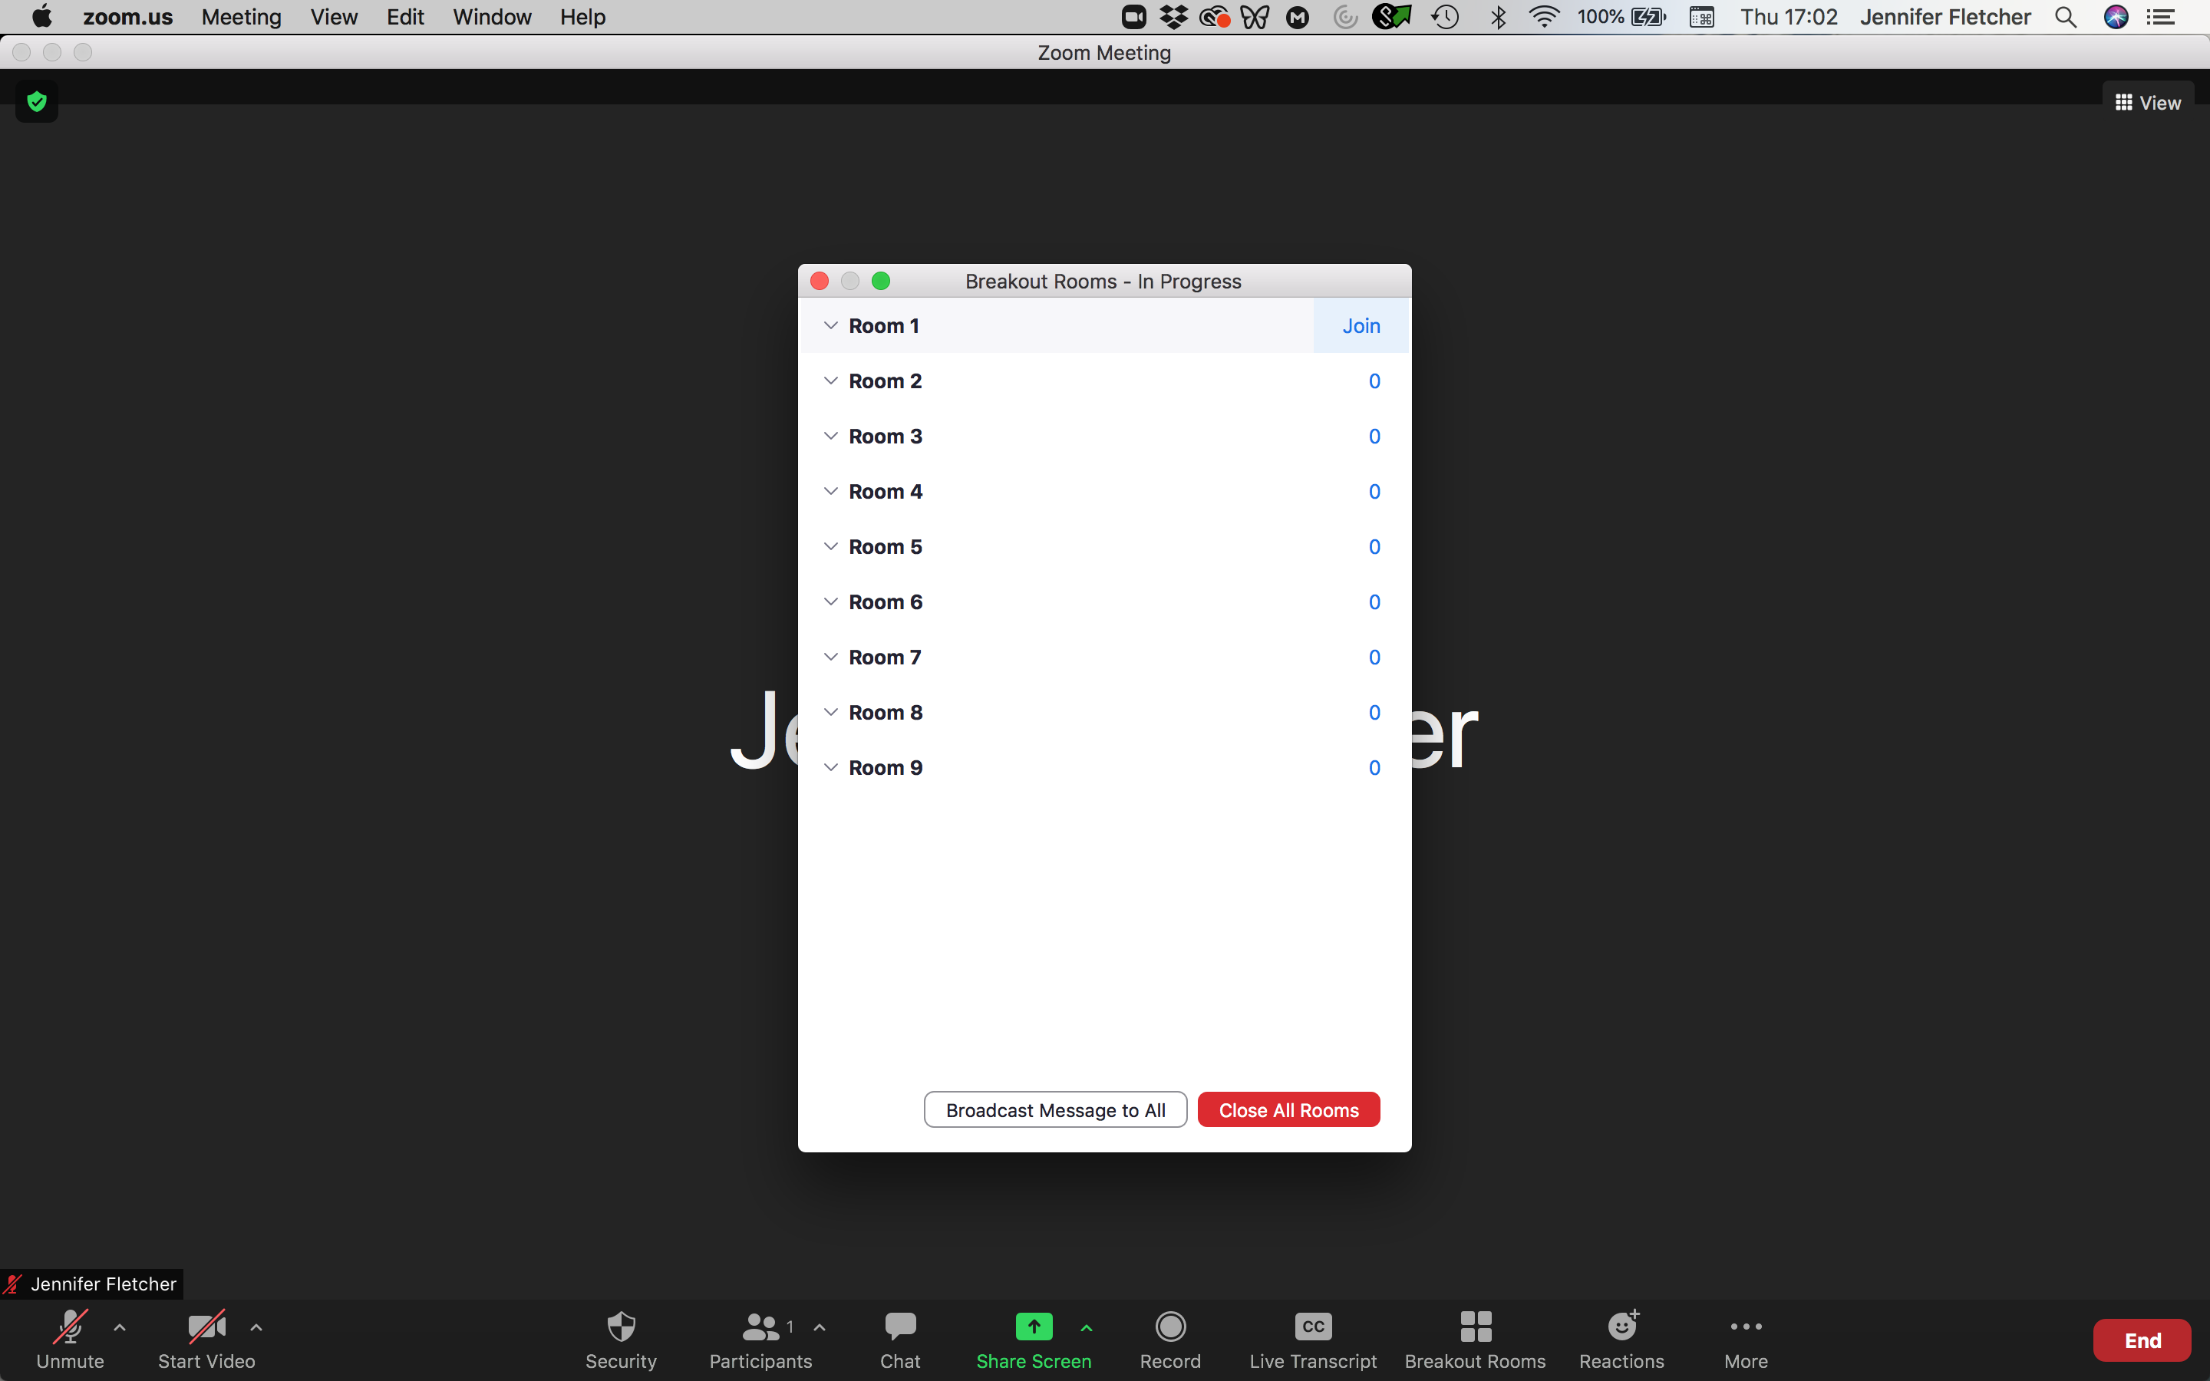
Daily Communications
Daily zoom meeting at 13:00 UTC
  Very short weather brief from each country.
  Very short report from each country on how things are going, including:
    Any feedback from users.
    Any technical or logistic challenges.
    Any issues with SOPs.
Zoom drop-in call open 09:00 UTC to 18:00 UTC
  One person from each Testbed location should keep this call open and muted. They do not need to monitor the call but keep it open and in hearing distance.
  If someone wishes to speak to someone at another Testbed location, they can join the zoom call and shout for them – hopefully someone will hear and come!
  The discussion can occur in a breakout room so as not to distract others who have the call open.

Slide 20
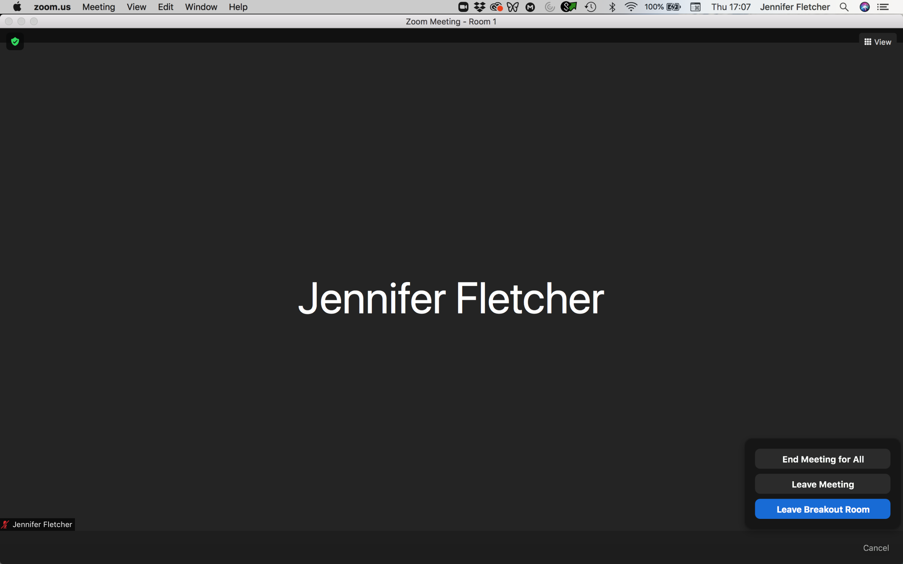
Daily Communications
Daily zoom meeting at 13:00 UTC
  Very short weather brief from each country.
  Very short report from each country on how things are going, including:
    Any feedback from users.
    Any technical or logistic challenges.
    Any issues with SOPs.
Zoom drop-in call open 09:00 UTC to 18:00 UTC
  One person from each Testbed location should keep this call open and muted. They do not need to monitor the call but keep it open and in hearing distance.
  If someone wishes to speak to someone at another Testbed location, they can join the zoom call and shout for them – hopefully someone will hear and come!
  The discussion can occur in a breakout room so as not to distract others who have the call open.

Slide 21
In-country testbed tasks
Carry out synoptic and high-impact weather forecasting using the synoptic SOPs, including filling in the templates. Deliver ensemble products to users once per day.
Carry out daily nowcasting following the nowcasting SOP, delivering nowcast products to users every two hours for the duration of the nowcasting time period each day.
Carry out objective verification of forecasts using methods learned in Verification Workshop.
Carry out subjective evaluation of nowcasts with users.
Each day, enter information from previous day’s storms into the nowcasting verification sheet. Information required is synoptic station observations during the storm, if available, and any information on storm impacts. Friday’s storms will be entered on Monday.
Ensure that required documents are uploaded to Redmine (or emailed to Jennifer as a last resort only if a Redmine account cannot be obtained).

Slide 22
UK Testbed tasks
Provide support/mentorship as needed for forecast verification, nowcast verification, and following synoptic and nowcasting templates.
Document storms that occur overnight so that a full record is kept.
Add NWCSAF information to nowcast evaluation sheet and add the nowcasts that were issued for that day.
Support and maintain the various web portals and running and processing of forecasts and ensembles.

Slide 23
Mid-point meeting
Friday 17 September
Presentation on forecast verification and on evaluation of forecast products from users.
Presentation on feedback on SOPs from forecasters.
Opportunity to refine and update SOPs for the second week of the Testbed.

Slide 24
Testbed 3 Legacy
Numerous users will be exposed to nowcasting products, and forecasters will have experience issuing nowcasts based on NWC-SAF products.
The nowcasting web portal will be available for nowcasting beyond the lifetime of SWIFT.
The final SOPs for synoptic forecasting and nowcasting will be recorded and made publicly available.
Users feedback on ensemble products and nowcasts will be documented and available as evidence of need/interest in these products.

Slide 25
Informal conversations
Join the TB3 Slack Channel: https://join.slack.com/share/zt-vn89aqvp-JdNhM8JTVXSB7RWYXCBjFQ
Tweet on #TB3AfricanSWIFT

Slide 26
Funder Acknowledgement
This work was supported by UK Research and Innovation as part of the Global Challenges Research Fund, grant number NE/P021077/1.

